Slide 1
Documenting: Unified Modeling Language (in a thimble)
UML is a standard for showing certain diagrammatic information
Class: 3 part box - [name, stored values, services]
Responsibility: free text above the box (typically (sadly) omitted).
Instance: like class, but underline & follow instance name with “ :classname ”
Relationship: near end names purpose, far end names shows number (0 .. max)
Generalization: all characteristics of supertype are available to subtype
Sequence diagram: shows messages passed; time goes down page
Collaboration diagram: messages passed (no time shown, number the messages)
Student
Course
Al:Student
E101:Course
F123:Course
id: integer
name: string
attends
0..5
time: time
name: string
1..max
register(Al)
register(courses)
int size( )
register(student)
register(Al)
1:register(Al)
E101:Course
Full-time Student
Al:Student
F123:Course
register(courses)
This documents the design at higher precision
2:register(Al)

Slide 2
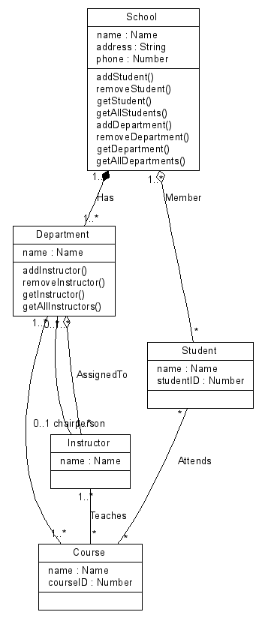
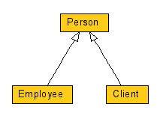
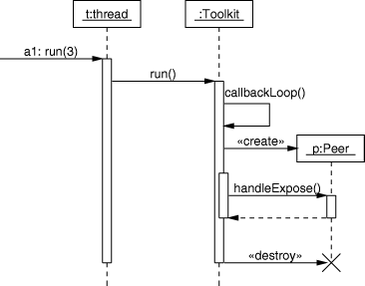
Documenting: Unified Modeling Language (in a thimble)
UML is easy to overuse; try to keep it simple.
Generalization (incomplete)
Class / relationship
Note diamonds for “has-a,” and regular lines for “uses”
http://www.spinellis.gr/sw/umlgraph/
Sequence
http://www.objectmentor.com/resources/articles/umlCollaborationDiagrams.pdf
http://www.spinellis.gr/sw/umlgraph/

